Slide 1


SUPPLIER SELECTION SUMMARY
Aaditya Siddharth M

Slide 2

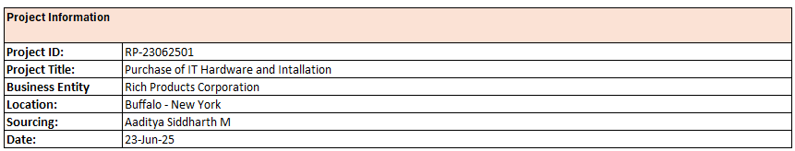
PROJECT DETAILS
PROJECT OVERVIEW:
Rich Products Corporation is seeking a qualified hardware supplier to provide laptops, desktops, and workstations under a fixed-volume procurement model. The goal is to establish a long-term sourcing agreement that ensures competitive pricing, adherence to technical specifications, and consistent fulfillment across North America. Proposals are invited from OEMs and authorized partners capable of meeting service-level expectations, delivery timelines, and supporting cost savings and operational efficiency.
SCOPE OF WORK:
1. Supply of laptops as per the technical specifications provided in Requirement Specification Sheet
2. Fulfillment of a fixed-volume procurement commitment over the defined contract period.
3. Competitive pricing structure with volume-based discounts and price lock-in for the contract duration.
4. Logistics support for delivery across multiple Rich Products Corporation locations in North America.
5. Provision of warranty, after-sales support, and escalation procedures.
6. Value-added services such as asset tagging, On site Maintenance and Technical Support

Slide 3
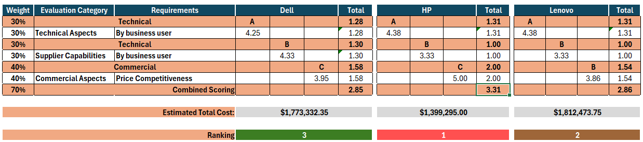
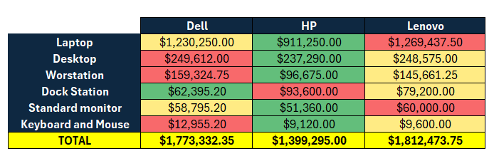
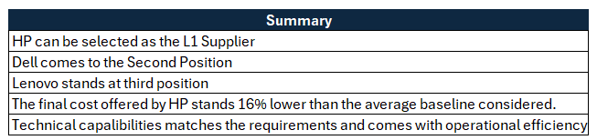
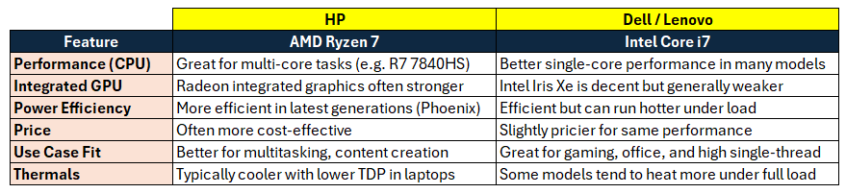
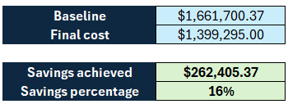
RFP DETAILS & SELECTION
COST ANALYSIS
Savings Achieved :

Slide 4
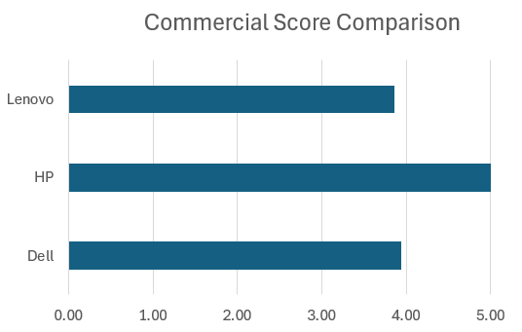
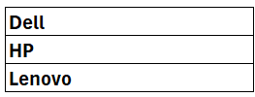
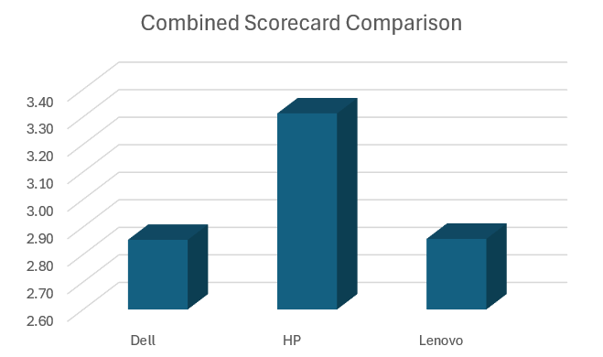
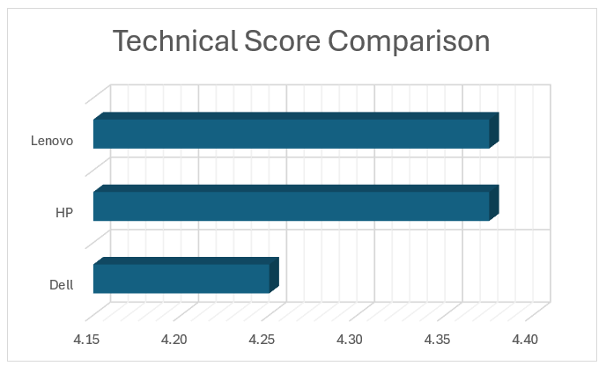
SCORING COMPARISON
NO OF SUPPLIER RESPONDED:
SELECTED SUPPLIER:
QUOTED VALUE:
HP
$ 1,399,295

Slide 5
THANK YOU

